Slide 1


Hash Table
Linear Probing

Slide 2


Group 2 Members
KOH Tito
LAY Chhay
HAK Kimhong
LONG Channleap
KHENG Dalish
CHORN Chanlakhna
CHOU Vandy
KRY Senghort
NGIM Panha

Slide 3
Agenda
1. Introduction
Presented by KHENG Dalish
2. Linear probing
Presented by LAY Chhay
3. Code Explanation by using linear probing
3.1 Insert
Presented by HAK Kimhong
3.2 Search
Presented by LONG Channleap
3.3 Delete
CHORN Chanlekhna
4. Time complexity
Presented by KOH Tito
5. Advantages and Disadvantages of Linear probing
Presented by CHOU Vandy
6. Linear probing vs Quadratic probing vs Double heshing
Presented by KRY Senghort and NGIM Panha

Slide 4
Introduction
What is Hash Table ?
What is Hashing ?
What is Hash Collision ?

Slide 5
Hash Table
is a data structure that implements a set abstract data type, a structure that can map keys to values. A hash table uses a hash function to compute an index, also called a hash code, into an array of buckets or slots, from which the desired value can be found.
Hash tables have to support 3 functions:
- insert (key, value)
- get or search(key)
- delete (key)

Slide 6
Hashing
Hashing is the process of transforming any given key or a string of characters into another value. This is usually represented by a shorter, fixed-length value or key that represents and makes it easier to find or employ the original string. The most popular use for hashing is the implementation of hash tables. A hash table stores key and value pairs in a list that is accessible through its index. Because key and value pairs are unlimited, the hash function will map the keys to the table size. A hash value then becomes the index for a specific element.

Slide 7
Hash Collision
Hash collision is a random match in hash values that occurs when a hashing algorithm produces the same hash value for two distinct pieces of data. Collisions in Hashing In computer science, hash functions assign a code called a hash value to each member of a set of individuals. It’s important that each individual be assigned a unique value. A collision, or more specifically, a hash code collision in a HashMap, is a situation where two or more key objects produce the same final hash value and hence point to the same bucket location or array index.

Slide 8
Linear probing
What is Linear probing ?
How does it work ?
The sample of Linear probing

Slide 9
What is Linear Probing?
Linear probing is a strategy for resolving Collisions or Keys that map to the same index in a hash table.
Strategy
Find index
If there is a collision

Slide 10
How does it work?
Linear probing is used to insert an element x, compute h(x) and try to place x there.
If it’s full, keep moving through the array, wrapping around at the end, until a free spot is found.
To look up an element x, compute h(x) and start looking there.
Move around the ring until either the element is found or a blank spot is detected.
When the spot is found, place the value of x in that spot.

Slide 11
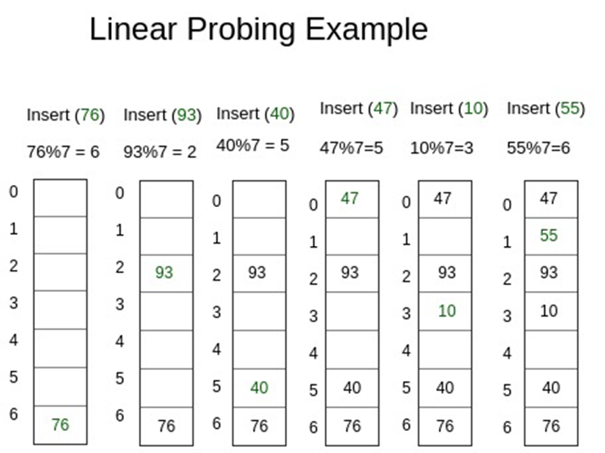
Here is the sample

Slide 12
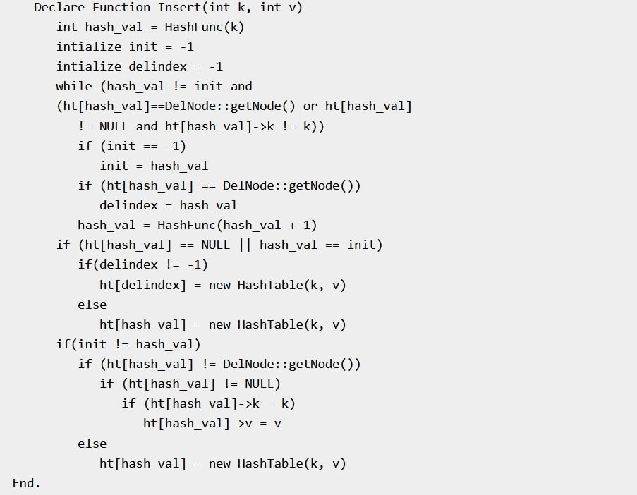
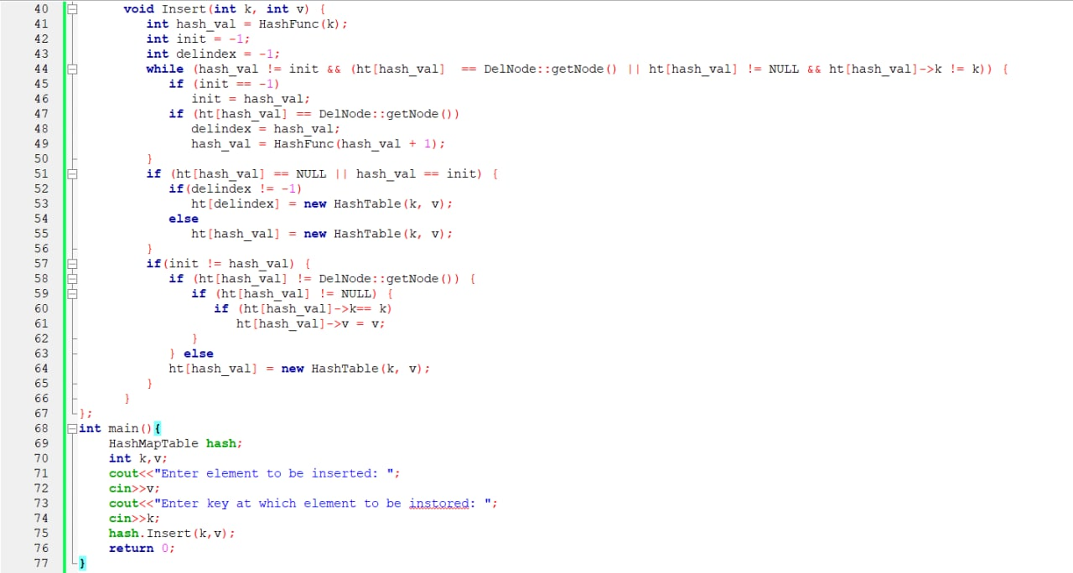
Code Explanation
Insert function
Algorithm
Code

Slide 13
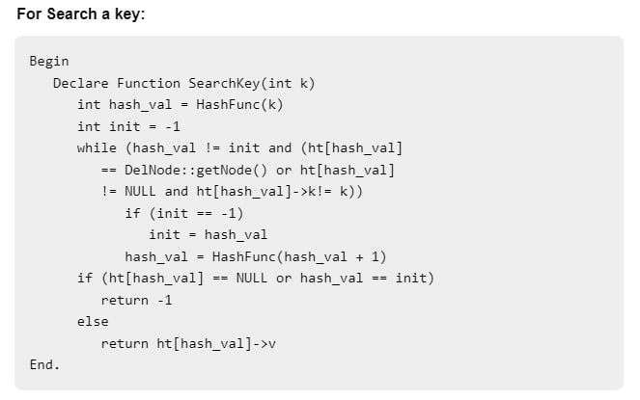
Search function
In Open Addressing, all elements are stored in the hash table itself. So at any point, size of table must be greater than or equal to total number of keys (Note that we can increase table size by copying old data if needed).
Search(k) – Keep probing until slot’s key doesn’t become equal to k or an empty slot is reached.

Slide 14
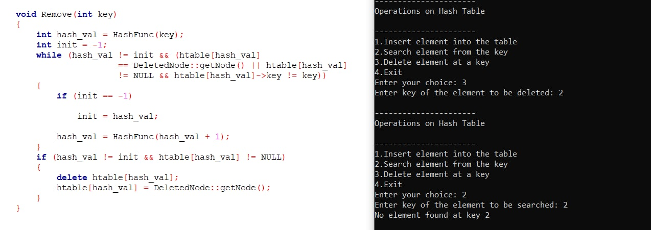
Delete function
Code

Slide 15
Time Complexity
Time complexity is the amount of time that is taken by the algorithm to run.
There are 3 types of measurement:
Worst-case
Best-case
Average-case
The time complexity of your code is described by Big O notation.

Slide 16
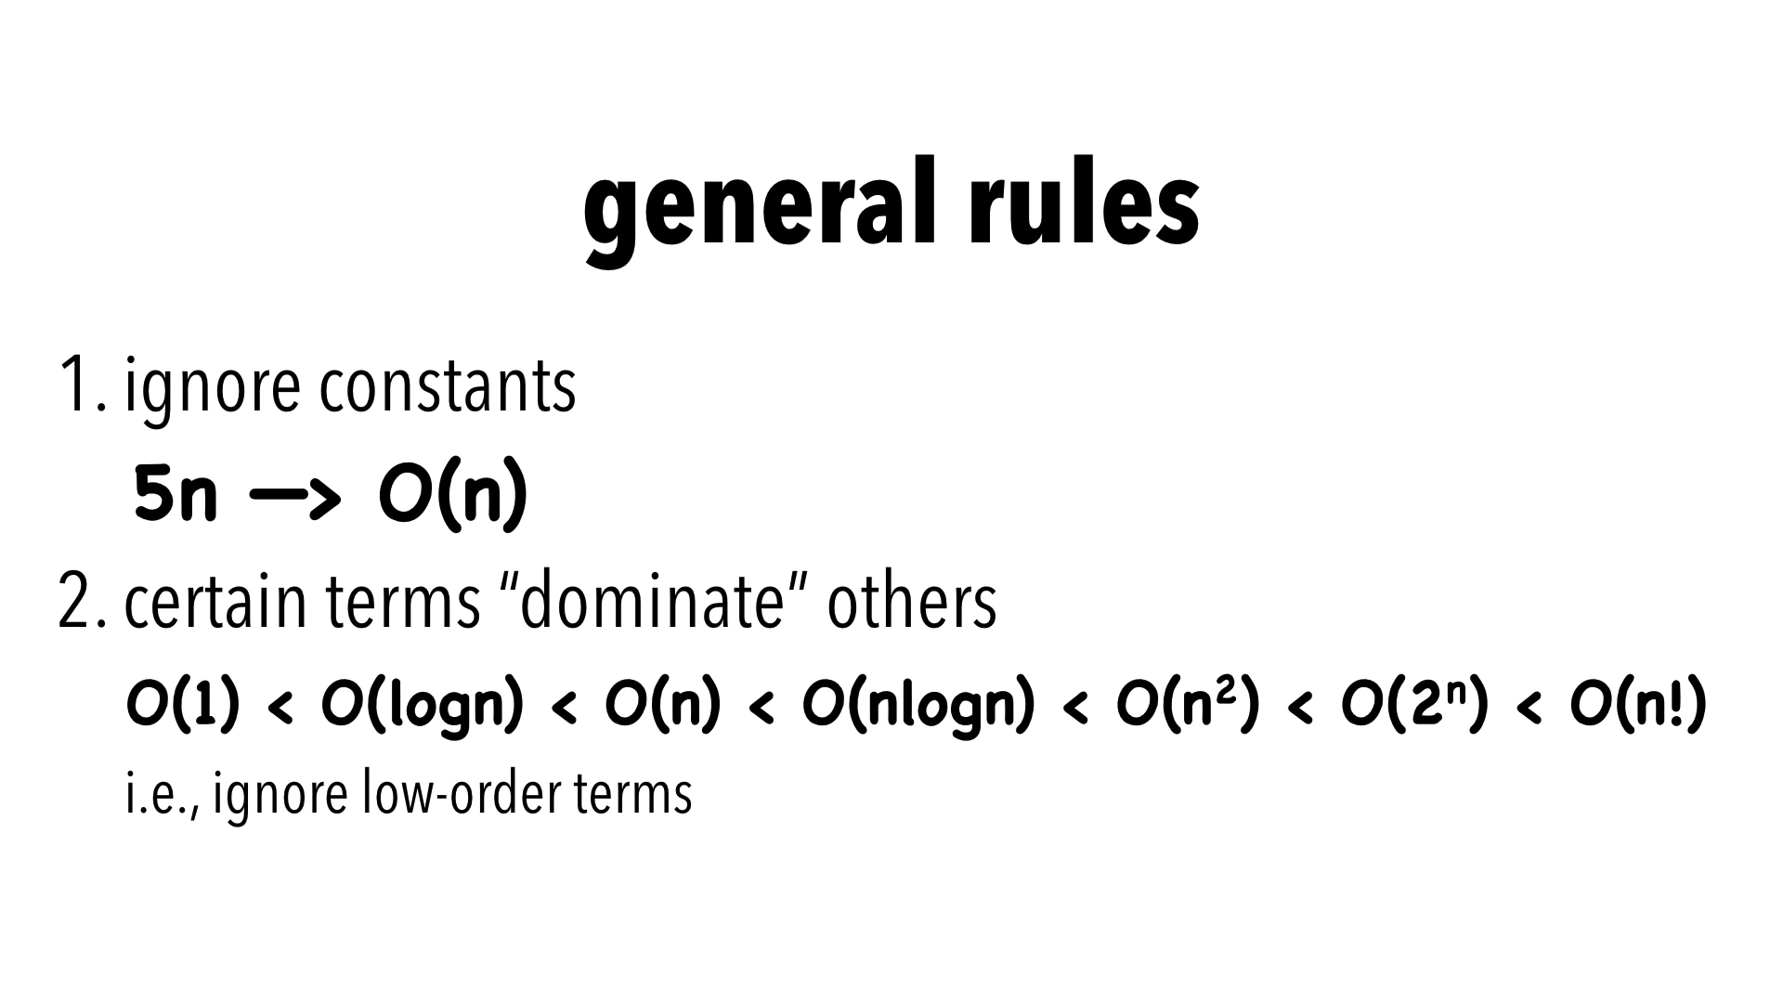
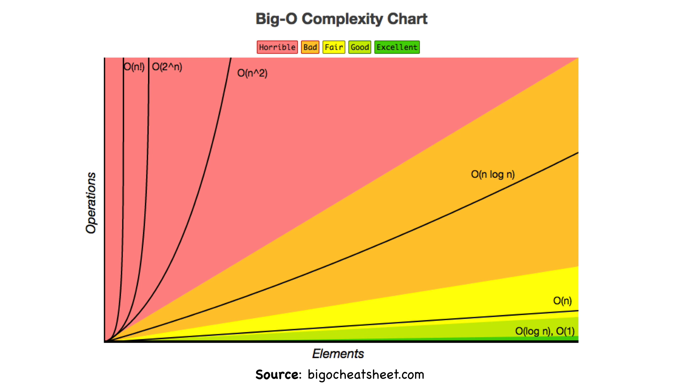
Rules and Chart

Slide 17
Time complexities of hash table with Liner Probing
Worst-Case Time complexity:
Find: O(n) - If all the keys mapped to the same index, we would need to probe over all n elements
Insert: O(n) - If all the keys mapped to the same index, we would need to probe over all n elements
Remove: O(n) - If all the keys mapped to the same index, we would need to probe over all n elements

Slide 18
Time complexities of hash table with Liner Probing
Average-Case time complexity
Find: O(1) - The formal proof is too complex for a summary slide.
Insert: O(1) - The formal proof is too complex for a summary slide.
Remove: O(1) - The formal proof is too complex for a summary slide

Slide 19
Time complexities of hash table with Liner Probing
Best-Case time complexity:
Find: O(1) - No collisions
Insert: O(1) - No collisions
Remove: O(1) - No collisions

Slide 20
Advantages and Disadvantages of Linear probing
Linear probing is a simple collision resolution technique for resolving collisions in hash tables, data structures for maintaining collection of values in a hash table. If there is a collision for the position of the key value then the linear probing technique assigns the next free space to the value.
Advantages
Linear probing requires very less memory
It is less complex and is simpler to implement
Disadvantages
Linear probing causes a scenario called "primary clustering" in which there are large blocks of occupied cells within the hash table.
The values in linear probing tend to cluster which makes the probe sequence longer and lengthier.

Slide 21
Linear probing vs Quadratic probing vs Double hashing
Linear probing
Quadratic probing
VS
Double hashing

Slide 22
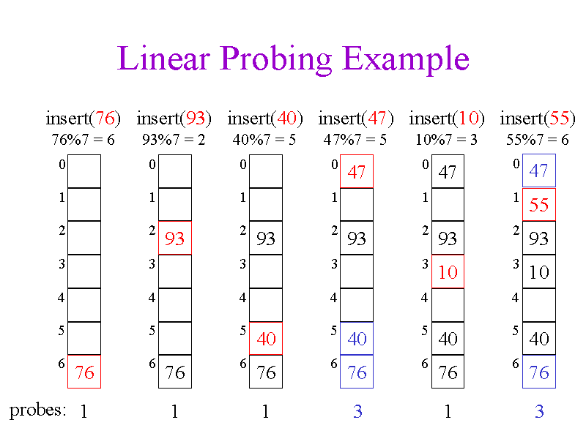
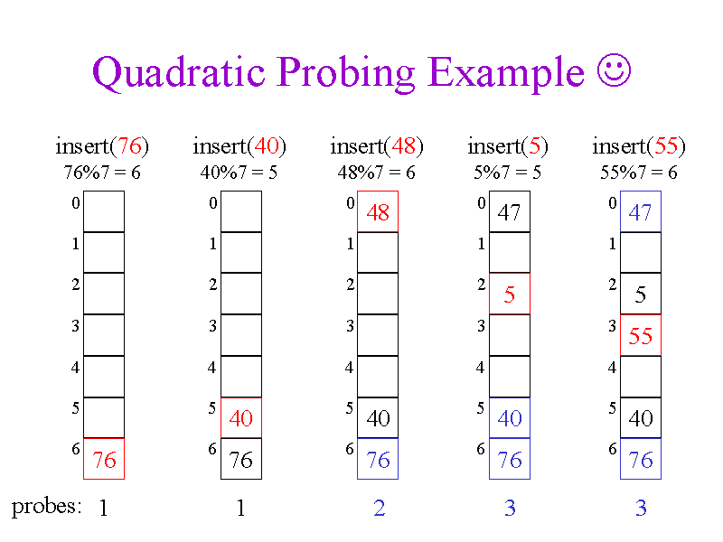
Characteristics of Linear and Quadratic Probing

Slide 23
Comparison between Linear Probing Vs Quadratic Probing
Linear probing
Faster implementation than quadratic probing
Use few probes
A problem occurs known as primary clustering
Quadratic probing
Easy to implement and deploy but slower than Linear Probing
Use extra memory for links and it does not probe all location in the table
A problem occurs known as secondary clustering
Interval between probes is fixed-often at 1
Interval between probes increases proportional to the hash value
vs

Slide 24
Characteristics of Linear Probing and Double Hashing
Linear probing
Function:
In linear probing, the hash table is searched sequentially that starts from the original location of the hash. If in case the location that we get is already occupied, then we check for the next location. The function used for rehashing is as follows: rehash(key) = (n+1)%table-size. For example, the typical gap between two probes is 1 as seen in the example below.
Let hash(x) be the slot index computed using a hash function and S be the table size
If slot hash(x) % S is full, then we try (hash(x) + 1) % S
If (hash(x) + 1) % S is also full, then we try (hash(x) + 2) % S
If (hash(x) + 2) % S is also full, then we try (hash(x) + 3) % S
Double hashing
Function:
Double hashing is a computer programming technique used in conjunction with open addressing in hash tables to resolve hash collisions, by using a secondary hash of the key as an offset when a collision occurs.
let hash(x) be the slot index computed using hash function.
If slot hash(x) % S is full, then we try (hash(x) + 1*hash2(x)) % S
If (hash(x) + 1*hash2(x)) % S is also full, then we try (hash(x) + 2*hash2(x)) % S
If (hash(x) + 2*hash2(x)) % S is also full, then we try (hash(x) + 3*hash2(x)) % S

Slide 25
Linear probing Vs Double hashing
Linear probing
Linear probing has the best cache performance but suffers from clustering. One more advantage of Linear probing is easy to compute
Linear probing is a strategy for resolving collisions, by placing the new key into the closest following empty cell
Double hashing
Double hashing has poor cache performance but no clustering. Double hashing requires more computation time as two hash functions need to be computed
A hash collision occurs when the hash function maps a key into a cell that is already occupied by a different key
Suffers from clustering and easy to implement
The only difference between double hashing and linear probing is that in double hashing technique the interval used for probing is computed using two hash functions. Since we apply the hash function to the key one after the other, it eliminates primary clustering as well as secondary clustering

Slide 26
Thank you for your time!
Do you have any question ?

